Slide 1


Automated Retail Store
CS - 684 Embedded Systems
Spring 2018
Group Members :
Deep Modh
Neeladrishekhar Kanjilal
Anuja Parab

Slide 2
Goal of the Project
01
The idea is to make a store where customers can purchase products without using a cashier or checkout station.
02
The customers should never have to wait in a line.
03
Just Walk Out shopping experience.

Slide 3
Understanding the problems
01
Knowledge of WHAT the customer is buying. Real-time tracking of weights of the racks in a shelf where the products are placed.
02
Knowledge of WHERE the customer is buying. Real-time positional tracking of customers, to get the shelf of interest.
03
Knowledge of HOW the customer is buying. A mobile application that will keep track of the actions and charge accordingly on exit.

Slide 4
Requirements
Digital Load Cell Weight Sensor
Hx711 Weighing Sensors ADC module
Esp32 Wifi Bluetooth Development Board
Mobile device with a GPS tracker*
AWS IoT Services and a Mobile Application

Slide 5
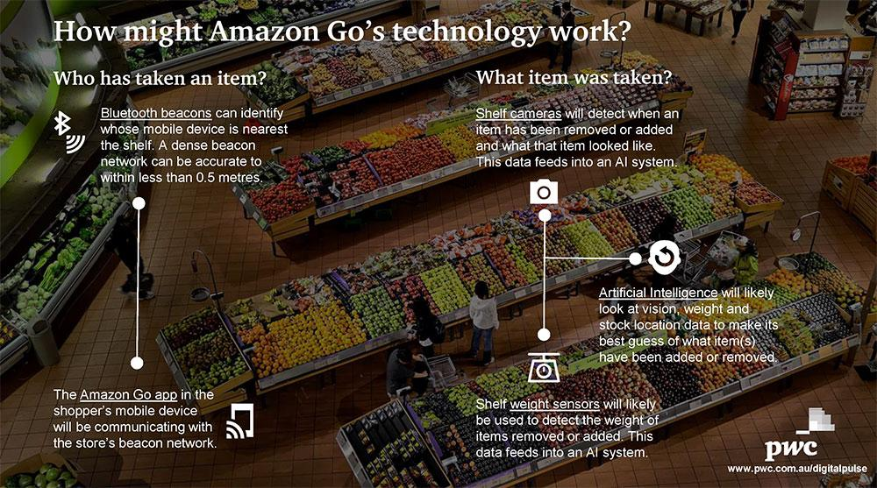

Slide 6
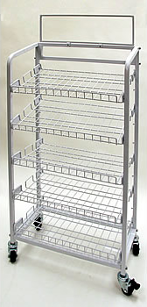
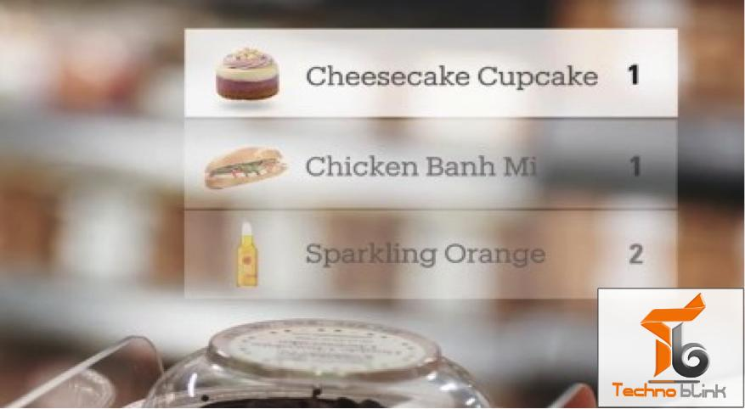
Deliverables
Showcasing how our tools would work
We will have specialized shelves where each of its rack would have its own weight tracking mechanism.
The mobile application would keep a track of the products which a customer picked and show it accordingly.

Slide 7
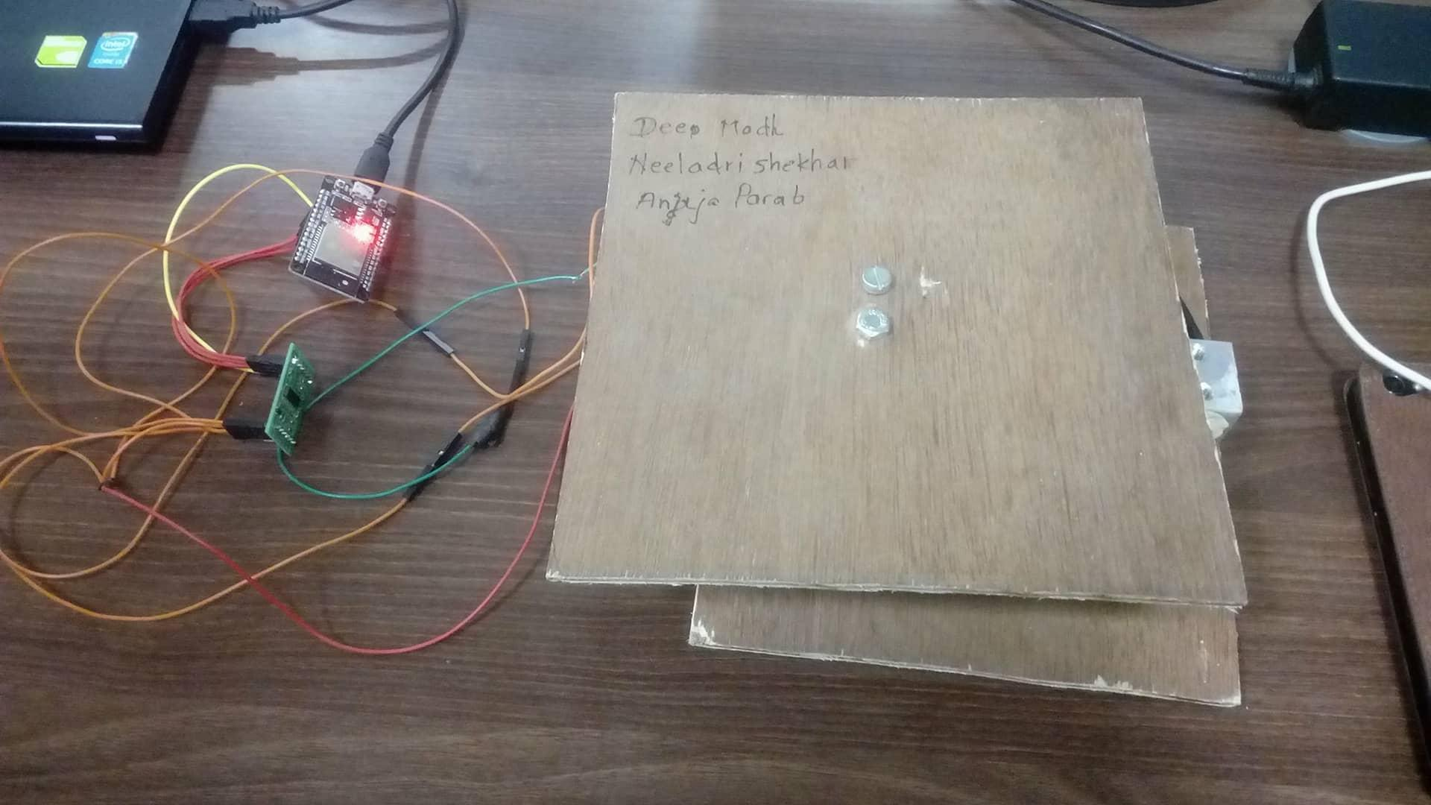
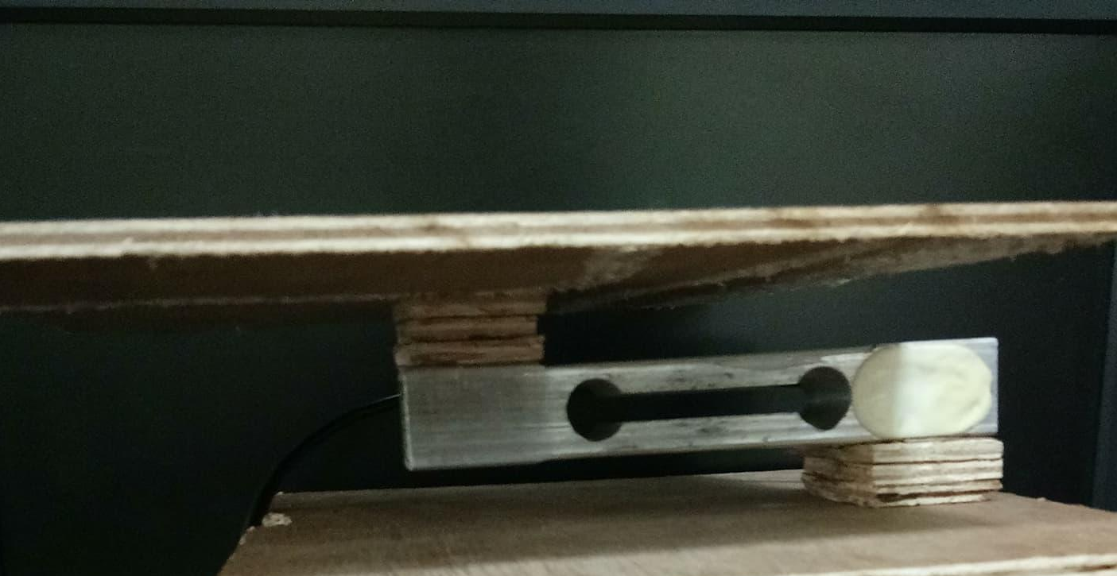
Deliverables
The weight trackers ...
The Digital Load Cell Weight Sensor will give Analog signals corresponding to the weights.
This is then transferred to the Hx711 Weighing Sensors ADC module for getting a Digital value of the weights.
These values will be uploaded to Cloud using the Esp32 wifi module(Relying on the AWS IoT services at the backend)

Slide 8
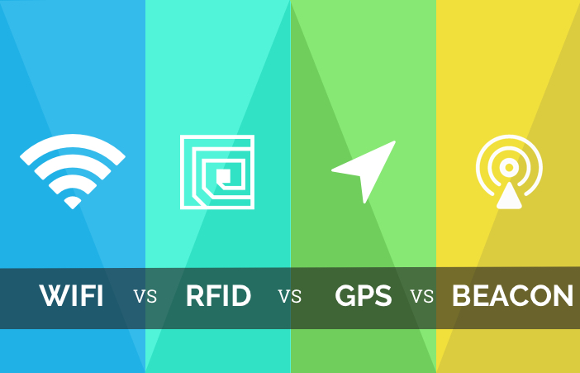
Deliverables
The position trackers ...
Primarily we had planned to rely on the inbuilt GPS of the mobile device which have an accuracy of less than half a meter.
On a terrace/balcony based store this method of tracking works really well.
However for indoors(within walls), because of attenuation and scattering, the accuracy of GPS may drop significantly. Solutions to these would be using beacon tracking based upon Bluetooth, Wifi or RFID.
The prototype uses the in-built wifi module of esp-32 and the consumer mobile for localizing.

Slide 9
Challenges
Returning products to unassigned shelves
Have a different returning area for collecting
Have products with weights never in multiples
Tagging every product separately for tracking
Exact position of customer picking the product
Using supportive iBeacon technologies
Localization using Wifi fingerprinting
Multiple customers near a shelf
Have smaller width shelves
Multiple weight trackers on the same rack

Slide 10
Test Strategies
04
Prototype
Refine
Make at least 2 of the localized digital weighing mechanism
Setup the positions of shelves, racks accordingly. May vary on the tracking mechanism
01
03
Share
Get position
Upload weights to cloud and check for accuracy, latency and implementation delays
Implement GPS first. Get its limitations. If heavy failures then shift to iBeacon tracking.
02

Slide 11
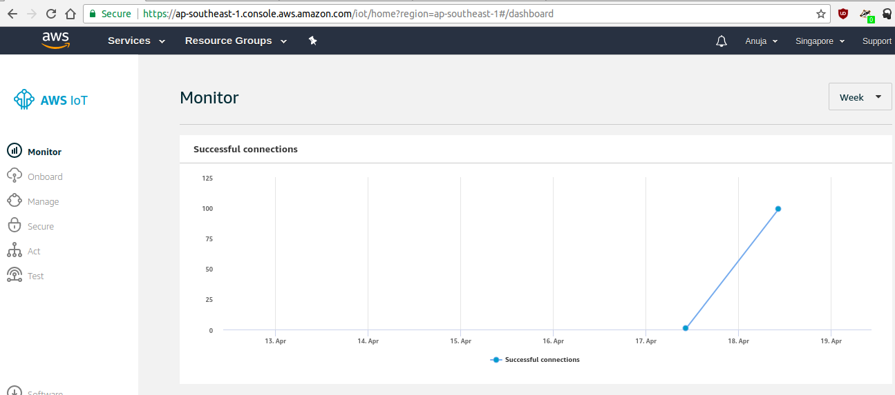

Slide 12
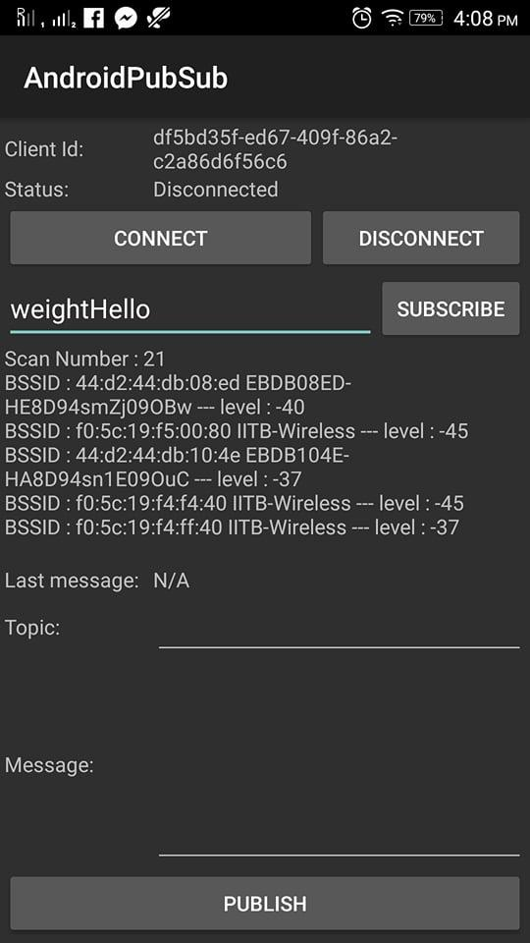

Slide 13
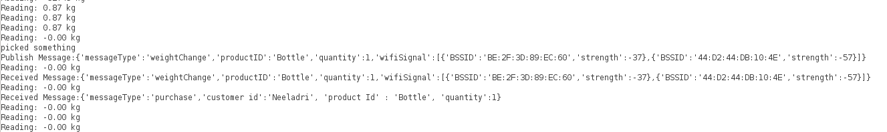
Arduino console output for ESP 32

Slide 14

Future Work
Implementation of a Database at the MQTT servers(AWS DynamoDB) for customer tracking and product management.
Scaling the model for multiple weighing scales across a common micro-controller, multiple product management, etc.
Implementation of different tracking models (viz. GPS, iBeacon, RF) for a more generalized purpose and testing its limits.
Cognito based user identification and implementing different roles via IAM policies for multiple User-Pools.

Slide 15
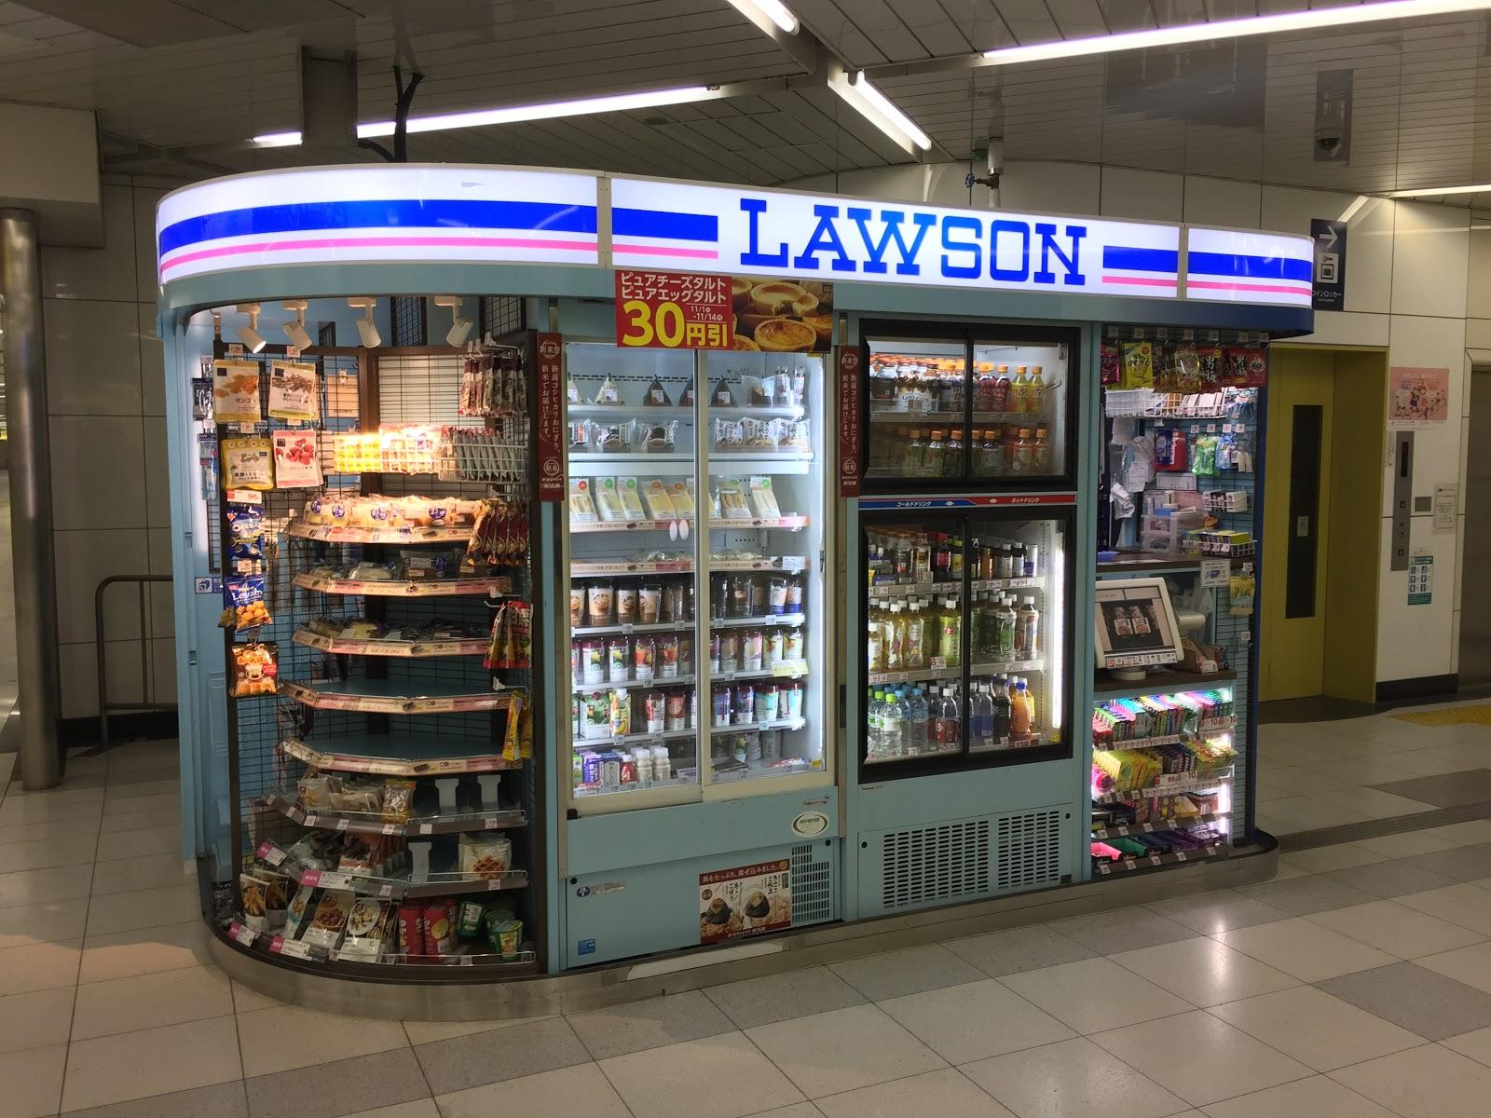
Thank you!
A working solution that exists today.
It works... and has similar ideas.
A store of only Vending machines

